Slide 1
Adversarial Autoencoders (AAE)
Alireza Makhzani University of Toronto 2015 arXiv

Slide 2
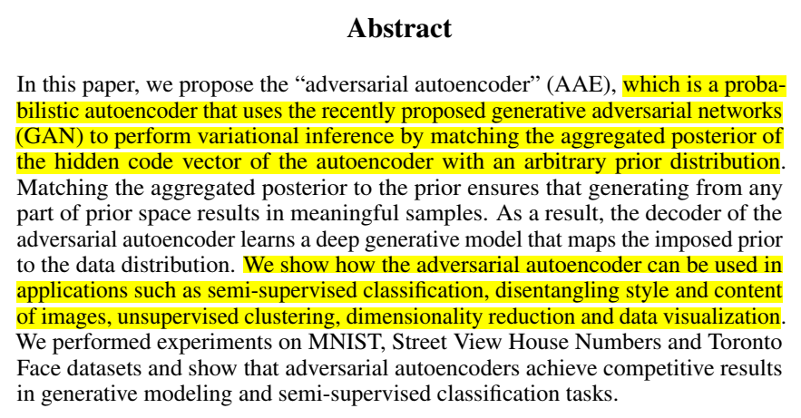
1
Scenario & Problem

Slide 3
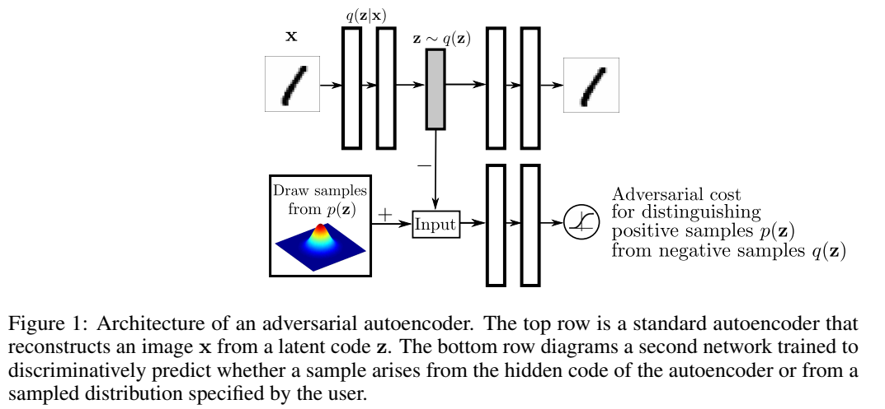
1
adversarial autoencoder

Slide 4


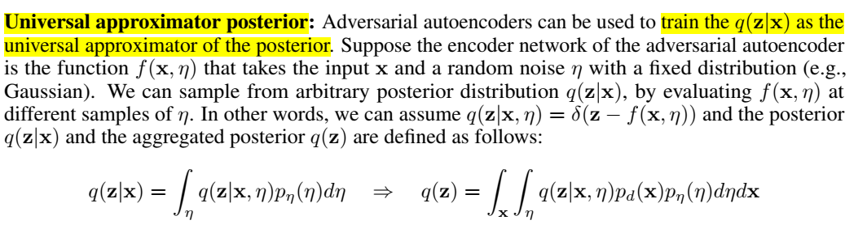
1
GAN变分推理

Slide 5
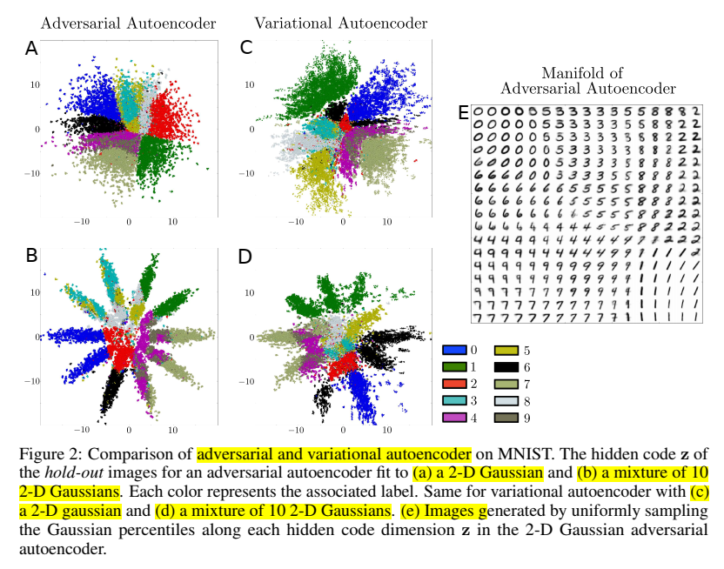
1
Comparison of adversarial and variational autoencoder

Slide 6
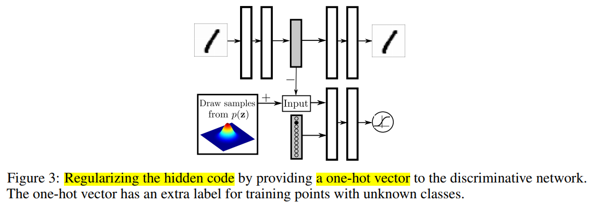
1
the training procedure for semi-supervised approach

Slide 7
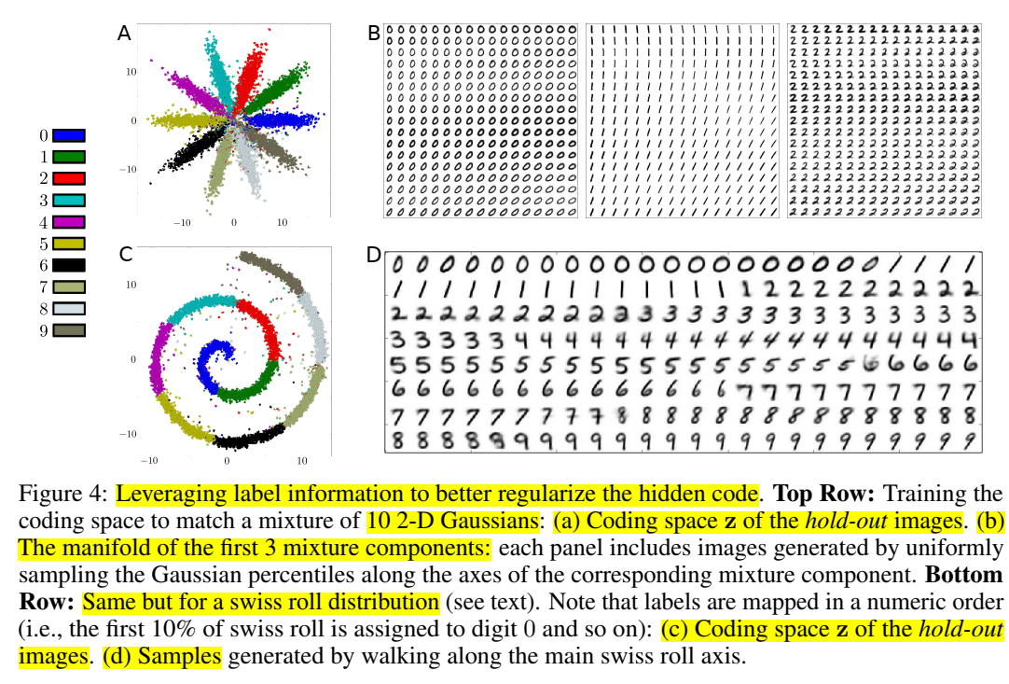
1
the latent representation of an adversarial autoencoder

Slide 8
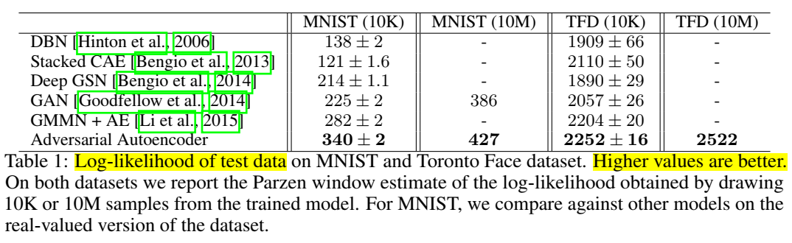
compares the log-likelihood of the adversarial autoencoder to state-of-the-art methods
1

Slide 9
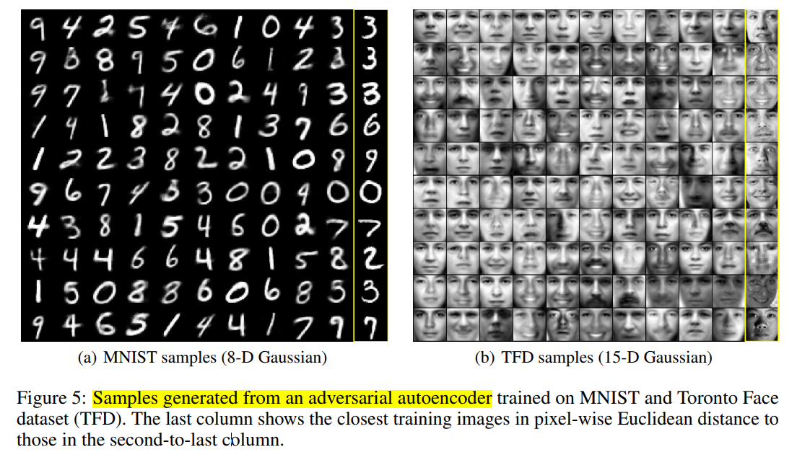
1
samples drawn from the adversarial autoencoder

Slide 10
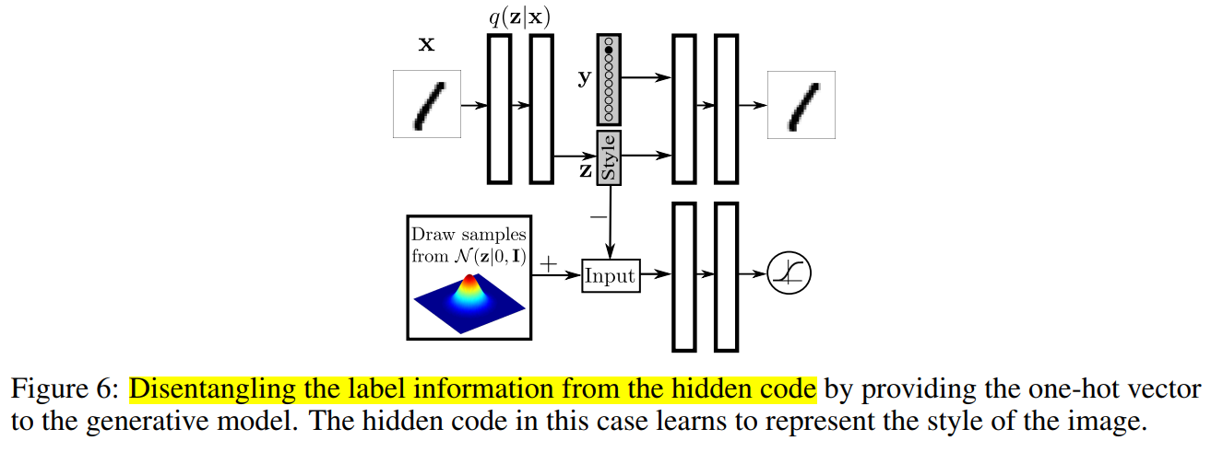
1
provide a one-hot vector encoding of the label to the decoder

Slide 11
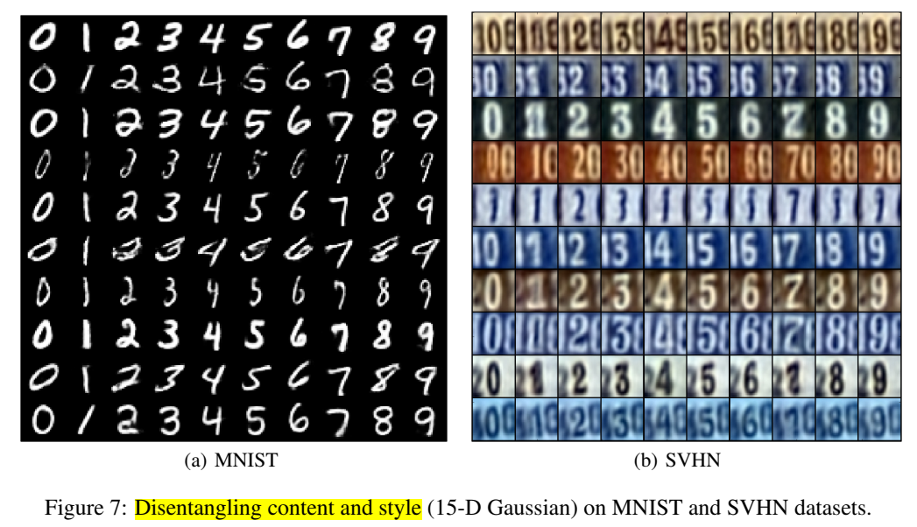
1
the hidden code is forced into a 15-D Gaussian

Slide 12
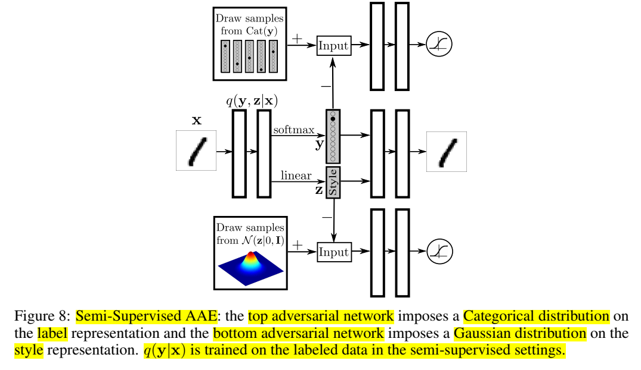
1
the inference network of the AAE
predicts both the discrete class variable y and the continuous latent variable z using the encoder q(z, y|x)

Slide 13
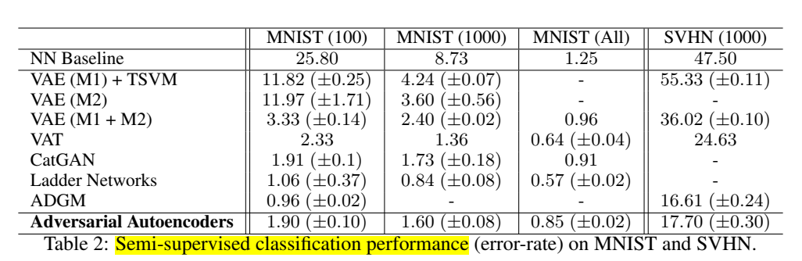
1
results of semi-supervised classification experiments

Slide 14
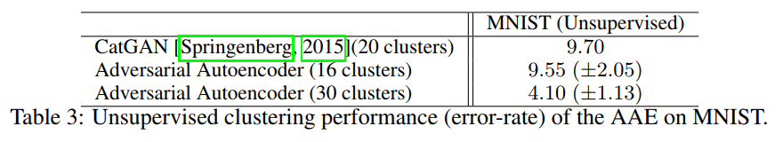
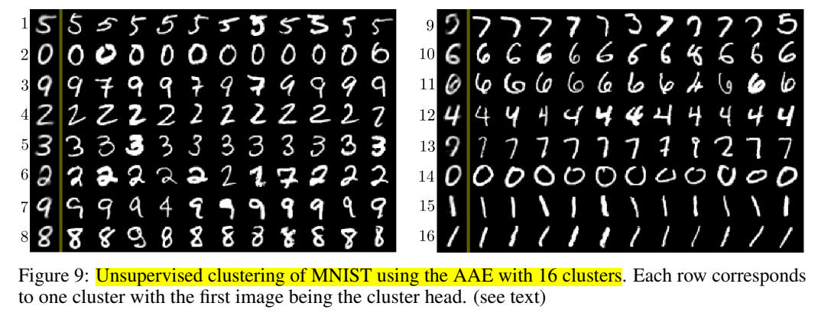
1
unsupervised clustering performance of the AAE on MNIST

Slide 15
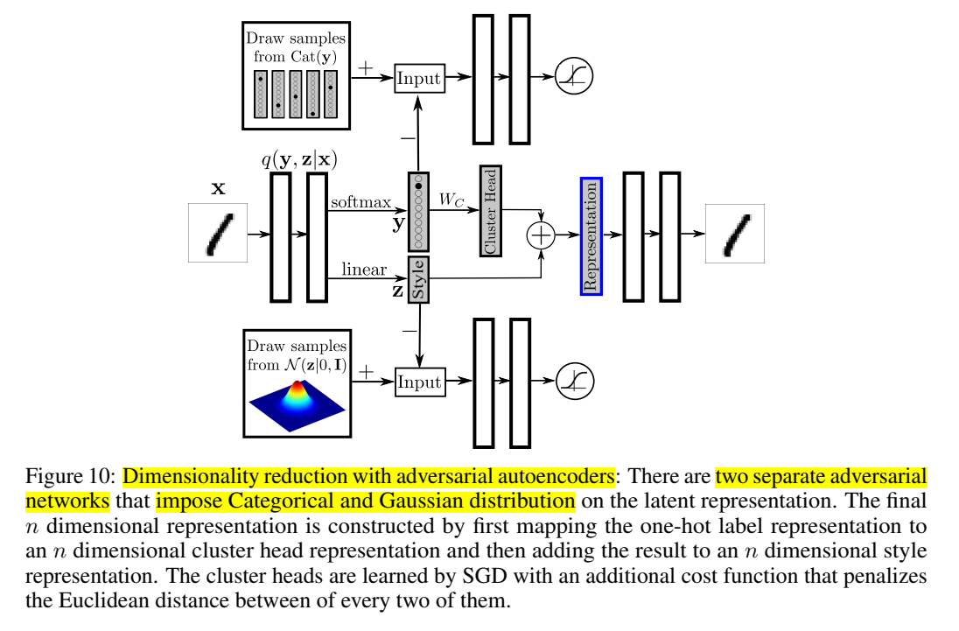
1
final Dimensionality Reduction representation
adding the n dimensional
distributed representation of the cluster head with the n dimensional style representation

Slide 16
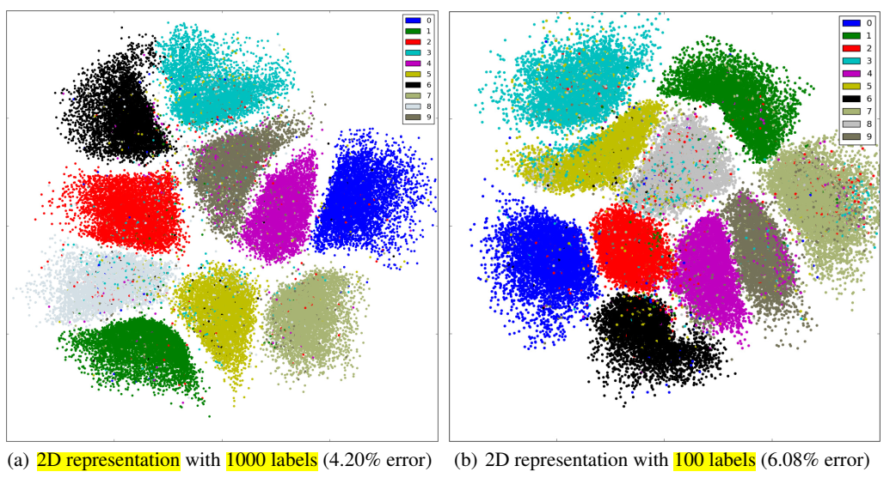
1
semi-supervised dimensionality reduction in n = 2 dimensions

Slide 17
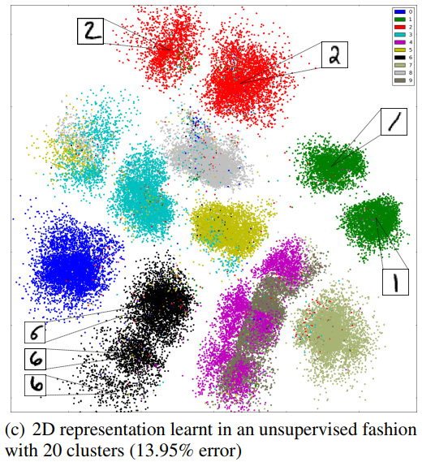
1
unsupervised dimensionality reduction in n = 2 dimensions

Slide 18
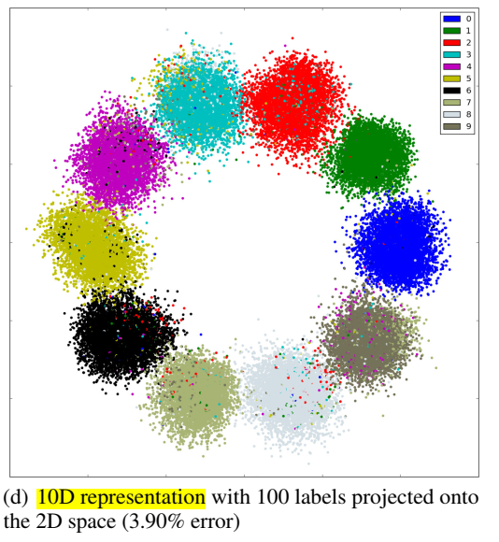
1
semi-supervised dimensionality reduction in n = 10 dimensions

Slide 19
4
Conclusion
概率自编码器，结合GAN的对抗思想，判别器和生成器辅助训练自编码器的encoder和decoder。
应用场景丰富：
半监督学习分类
分解图像风格信息和内容信息
无监督聚类
降维
数据可视化
对比VAE，变分推理思想。

